Slide 1
Welcome to the Contact Tracer Training

Slide 2
Note
All content in this module, including external resources, is for general information purposes only and is not intended to be used as a substitute for professional medical advice, diagnosis, or treatment, or to otherwise infer, predict, or interpret an individual's medical or health diagnosis. We encourage you to consult your physician if you have questions about COVID-19 or any other medical condition or treatment. Additionally, display of this badge does not represent endorsement by UCSF or Salesforce of your knowledge or, skill, or training pursuant to this module or qualification for any position in which such skill or training may be used. Furthermore, to the extent that this module includes any content or links to content belonging to third parties, the inclusion of said content does not reflect an endorsement by said third party of this module or otherwise create a relationship between Salesforce and said third party.

Slide 3
Starting the Conversation
Luis Gutierrez-Mock, MPH, MA
UCSF Pandemic Initiative for Equity and Action

Slide 4
Interviewing skills and setting the agenda

Slide 5
Learning Objectives
By the end of this session, the learner will be able to:
Define active listening skills to apply to interviews
Learn the steps to setting the agenda to begin interview process

Slide 6
Key considerations for interview
Establish rapport and build trust in a brief encounter
Demonstrate compassion in a time of distress
Recognize the unique needs of each person
Use a personalized approach to collecting required information
Notes:
1. Taking a contact focused approach to each call is important. Each person is unique in their circumstance and should be respected. We are in the same storm but not the same boat.
2. Tone of voice, how information is conveyed and how questions are asked help in building trust.
This is big…a lot of scary news, etc…We are calling someone who doesn’t know us…
It’s important to try and understand the experience of the person you are calling/the contact – listen to their responses…find ways to validate and be compassionate.
It’s important to recognize that you are asking a lot of personal questions which contact may not feel like sharing…ask questions, AND listen…see above.

Slide 7
Meet Elsie
Notes:
We’d like to ground our discussion about health coaching in a story by introducing you to Elsie. Elsie is one of the people on your contact list. She is 65 years old and emigrated from the Philippines when she was 14. Elsie was a middle school teacher for many years and recently retired. She speaks Tagalog and English.
Elsie is pleasant when you speak with her. A couple of times, she has to ask you to wait while she helps one of her grandkids get a snack. Elsie says she has a hard time keeping up with all the news about COVID-19 and finds the public health guidelines to be confusing. When you tell her that it is recommended that she quarantine for two weeks, she asks, “Well isn’t that what we’re doing right now?”
When you explain the difference between social distancing and quarantine, Elsie says: “That isn’t going to work for me. My daughter needs me or she can’t work and pay rent. My neighbors depend on me to bring them groceries. I need to walk my dog.”
Producers, in a moment I’d like you to open chat.
[Discussion]
· What challenges does Elsie face if she seeks to observe a quarantine? Please type your answers in the chat box.
[Open chat and read some of the responses]
· What strengths and resources does Elsie have as she seeks to observe a quarantine?

Slide 8
What is Health Coaching?
An approach that is:
Contact-centered: Meeting people where they are
Strength-based: Identifying and building on people’s knowledge and motivation
Collaborative: Engaging people as the experts in their lives to understand how to carry out behavior change
Notes:
As a culture, health coaching is an approach to talking with people that is client-centered, strength-based, and collaborative.
So what does that mean?
By client or case-centered, we mean meeting people where they are, in the complex context of their lives and prioritizing their values and concerns. In Elsie’s case, she is the central support of a wide social network. Her daughter, grandchildren, neighbors, and dog depend on her.
By strength-based, we mean that health coaching seeks to understand what people already know and what they are motivated to do, and to build on that knowledge and motivation. Elsie’s expansive social network may also be a strength as she seeks support for the period of quarantine.
Being collaborative means engaging people as the experts in their own lives to figure out how to carry out complex behavior change. In your conversation with Elsie, you will bring knowledge about COVID-19 and quarantine, and Elsie will be the expert in her life. Only by engaging her as an expert will you reach a plan that can fit into her life.

Slide 9
What is Health Coaching?
Health coaching is a set of tools to support people in gaining the knowledge, skills and confidence to care for their health.
Notes:
As a skillset, we define health coaching as a set of tools to support people in gaining the knowledge, skills, and confidence to be active participants in caring for their health.
We’re going to be sharing some of those tools in the videos that you will watch in a few minutes

Slide 10
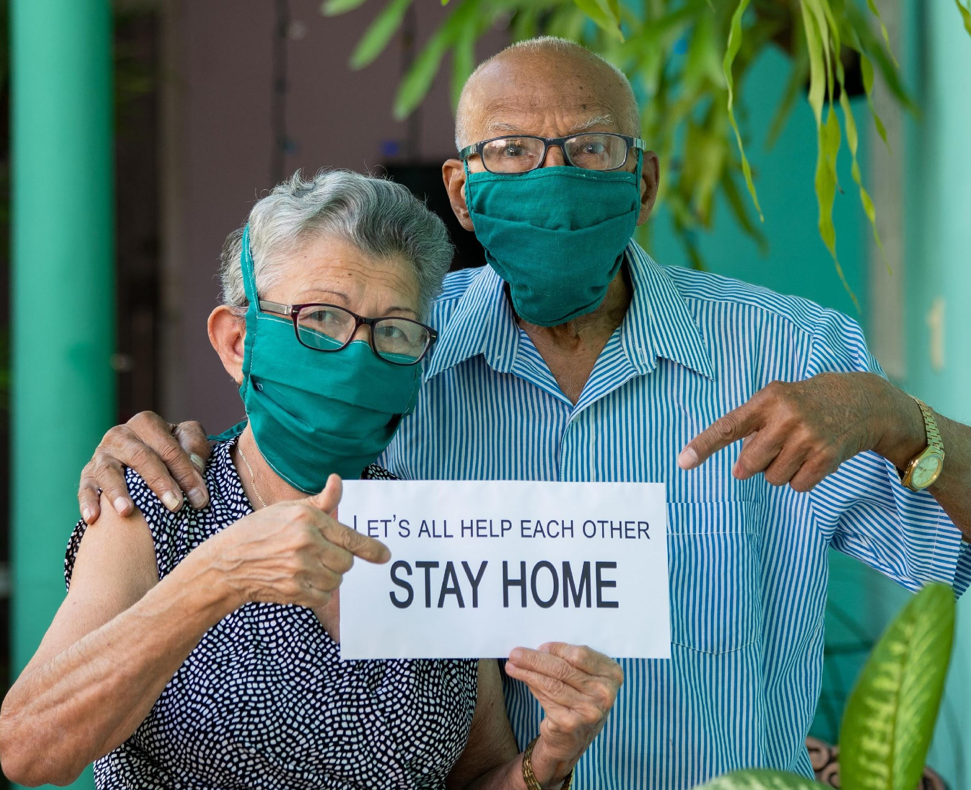
How is Health Coaching relevant to COVID-19 contact tracing?
Actions such as quarantine:
Require significant behavior changes
Are disruptive to people’s lives
Rely on understanding and buy-in
Notes:
Health Coaching has been researched extensively in chronic disease management and addiction.
So what does it have to do with contact tracing or case investigation for infectious disease?
Evidence shows that health coaching tools are effective in supporting people in making difficult changes to their daily lives. Much like improving diabetes control or quitting smoking, adhering to a quarantine involves behavior change and is not easy. It may require changing our social relationships and our physical space. There are practical barriers, such as whether people have food and other supplies or how they will communicate with workplaces about not coming in.
In order to be successful, people need an understanding of why the importance outweighs the inconvenience. That means building their knowledge. They need to be able to identify and break down the barriers they are facing and to navigate available resources. As a contact tracer or case investigator, that means helping them think of viable solutions that work in their own lives.
Health coaching offers tools to help address these core needs.

Slide 11
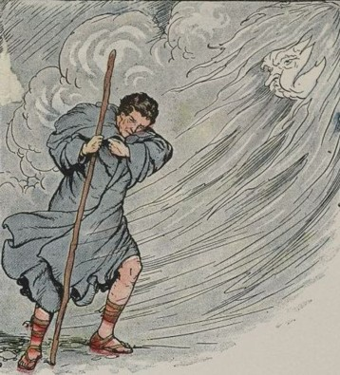
The Spirit of Health Coaching: The Wind and the Sun
Notes:
Aesop’s Fables tells the story of the Wind and the Sun. The Wind and the Sun were arguing about who was the strongest. The Wind proposed a competition: “See that traveler? Let’s see who can remove his cloak from him.” The sun agreed.
The wind went first. He howled and whipped around the traveler, tearing the cloak almost off him. But the traveler only wrapped the cloak more tightly around himself. Finally the wind exhausted himself.
The sun was next. He smiled warmly upon the traveler, gently increasing in intensity. The traveler stopped to rest, removing his cloak.
Sometimes when we seek to engage people in behavior change, we try to overwhelm, use shame, argue. The sun encourages, empathizes, affirms, nudges, reflects, and nurtures.
Approach to helping people find a motivation and act on it.
Today, as you think about how to explore the challenges that you may experience as a contact tracer or case investigator, I’d like you to come back to this image – what would it look like to be the sun?

Slide 12
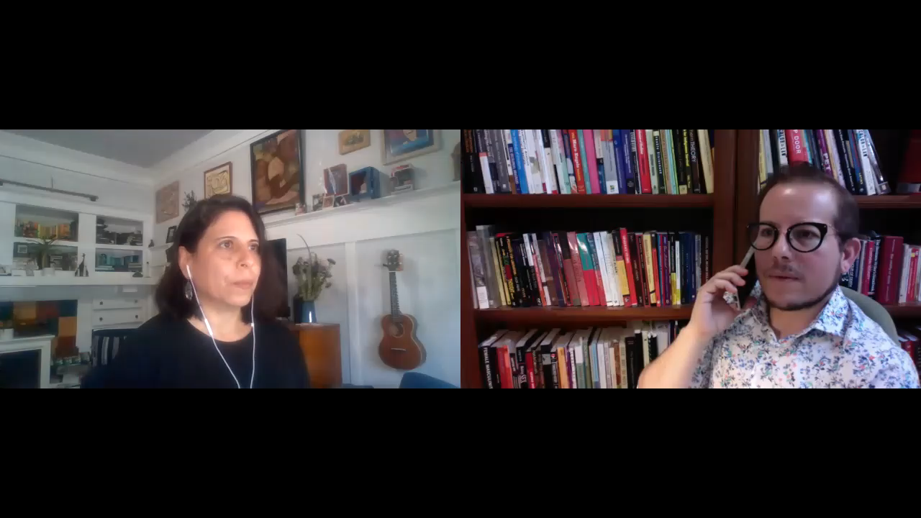
Video
Reflective statements – The Wrong Way
Notes:
Let’s look at an example of what it might look like to be the wind.
[Play video]
I’d like to ask you to share a word or phrase to describe how you think this contact is feeling?
I think it’s important to notice that the contact tracer in this video did something that a lot of us do: when faced with what felt like resistance, she pushed back. She said, “This is important!” She urged the contact to think about the consequences if he did not quarantine.
Even though both of those things are true, many of you have observed that this contact ended frustrated and feeling unheard. We’re talking to share an alternative to that kind of wrestling match.

Slide 13
Principles
Express Empathy
Support Self-Efficacy
Develop Discrepancy
Roll with Resistance
Notes:
Express Empathy
This refers to the contact tracer’s ability to understand with sensitivity and accuracy (but not sympathetically) the contact’s experience and feelings.
Support Self-Efficacy
Affirm strengths and competencies
Support optimism that change is possible.
Communicate that the decision & responsibility to change belongs with the person
Believe in the person’s ability to make positive changes in their life
Developing Discrepancy
Enables the contact to see that his/her present situation does not necessary fit into her values and what they would like in the future
The principle of developing discrepancy is based on the understanding that motivation for change is created when the person perceives a discrepancy between their present behavior and important personal goals
How does continuing to go to work fit into with your interest in not exposing family or friends?
Roll with Resistance
Resist the urge to correct the contact – people don’t like being told what to do.

Slide 14
Active Listening Skills
Open Ended Questions
Affirmations
Reflective Listening
Summarizing
Notes:
This is a scripted interview and you want to gather information in a succinct and direct manner. There are times however, when the following core interviewing skills will come in to play and useful to engage the person in completing the interview and considering the recommendations.
OARS is a common acronym used in many counseling styles and it can help you move more smoothly through the interviewing process. It stands for
Open-Ended Questions; Questions that cannot be answered by yes/no, Questions that begin with How, What would you do…Can you tell me …These will be used sparingly in this interview process, but may be helpful to interject to understand the unique experience of the person being interviewed.
Affirmations: As the person responds to questions, in almost all cases they give you information about their concern, their abilities, their willingness to communicate honestly with you. When appropriate affirmations help to connect and engage the person. ” it is clear you care deeply about your family”, “ It is impressive that you work so hard to provide for family” “Your questions show me that you are really interested in doing what you can to protect people”
Reflective Listening: People may communicate affect in their responses that may need to recognized and validated. Reflective listening acknowledges the affect and helps to engage and then respond to the person’s concern. ”You are anxious that the information I get from you will not be confidential”. “ You are frustrated with all the changes that have taken place”,
Summarizing: Summarizing the person’s statements and concerns helps to understand their needs for support, further resources and can help to check with your understanding of their unique experience.

Slide 15
OARS: Open-Ended Questions
Open questions invite others to “tell their story” in their own words without leading them in a specific direction. When asking open questions, you must be willing to listen to the person’s response.
Open questions are the opposite of closed questions. Closed questions typically elicit a limited response such as “yes” or “no.” The following examples contrast open vs. closed questions. Note how the topic is the same, but the responses will be very different:
Have you heard about the risk of COVID-19?
What can you tell me about the risk of COVID-19?
Notes:
O stands for “Open ended questions”
Close ended questions are questions that can be answered with a yes/no response. We hear a lot of these in our daily lives. For example:
· Do you know what COVID-19 is?
· Do you have any questions?
· Have you been social distancing?
Each of these questions invites a single word response. Let’s contrast that with these questions… [Read from slide]
These are questions that invite us to tell our story.

Slide 16
Open-Ended Questions
Where do you get support in managing tough situations?
Why is it difficult for you to access testing?
Tell me about your concern in following the recommendations?
What do you know about COVID-19?
What support do you need in order to quarantine?
How will you be able to make sure you have enough food or supplies for the period of time needed?
What is the first thing you need to make these recommendations work?
Tell me about your concern with the information I just gave you?
Notes:
These type of questions cannot be answered by a Yes or No and help to get a better picture of the individual’s concerns and situation. It helps with giving relevant information, referrals and appropriate recommendations.
----a contact may say “I am not sure what do with all the information you gave me”---
Closed-ended questions are used often in the interview to gather information that is needed but open-ended questions make it more centered on the individual.

Slide 17
OARS: Affirmations
Affirmations are statements and gestures that recognize client strengths and acknowledge behaviors that lead in the direction of positive change, no matter how big or small. Affirmations build confidence in one’s ability to change. To be effective, affirmations must be genuine.
I appreciate that you are willing to speak with me today
You are clearly a very resourceful person
You handled yourself really well in that situation
That’s a good suggestion
If I were in your shoes, I don’t know if I could have managed nearly so well
Notes:
The A in OARS stands for Affirmations. Affirmations are a chance to celebrate what someone is doing well or what they know. For example: [Read a few examples]

Slide 18
OARS: Reflection
Reflective Statements: Put into your own words what the person is saying
Tells the person – I am listening to you. What you say matters more than what I say.
Helps the person hear what THEY are saying.
Said as a statement rather than a question.
Notes:
Reflections give the message I am listening to you. You know best about you.
3 reflections to each question. Questions demand an answer and can sound judgmental. ex: Why aren’t you staying home?” “Why haven’t you stayed home as we discussed”. Which is often code for “as I discussed”.

Slide 19
OARS: Reflections
Repeating or rephrasing: Listener repeats or substitutes words or phrases, and stays close to what the speaker has said.
Paraphrasing: Listener makes a restatement in which the speaker’s meaning is inferred.
Reflection of feeling: Listener emphasizes emotional aspects of communication through feeling statements. This is the deepest form of listening.
Notes:
There are different kinds of reflective statements. Think of reflective statements as a small gift that you are offering to someone when you listen carefully enough to distill down the essence of a feeling or idea.

Slide 20
OARS: Summaries
Summarizing helps to ensure that there is clear communication between the speaker and listener.
Structure of Summaries…
Begin with a statement indicating you are making a summary - for example:
Let me see if I understand so far…
Here is what I’ve heard. Tell me if I’ve missed anything.
Be concise.—with information and interests you have heard
End with an invitation - for example:
Did I miss anything?
If that’s accurate, what other points are there to consider?
Anything you want to add or correct?
Notes:
Finally, the S in OARS stands for “Summary”
A summary is like handing someone a bouquet of their thoughts from a conversation and an invitation to action. For example, we might [read from slide]

Slide 21
Practice | Reflection
Notes:
In our skills lab today, we will focus on affirmations and reflective statements, because these are remarkably powerful tools to connect and to help people crystalize their own feelings and thoughts.
((this is an unfamiliar way to talk to people and it’s really helpful to practice))
Reflective statements are particularly hard for people.
Read these statements think of a reflective statement to make in response.
1. This is so unfair! I wear my mask and do everything I’m supposed to do, and still I get this?
2. First we have to shelter in place for months, and now I’m in quarantine for two weeks? How can anyone expect me to keep a job at this rate?
3. There is no way I’m not seeing my boyfriend for two weeks. I’m not even sick!
Notice that there’s a lot of emotion behind some of the statements. Reflective statements can be a tool to start to defuse some of that emotion.
((A lot of time when you hear emotion behind what people are saying, that’s often a good time to use a reflective statement))

Slide 22
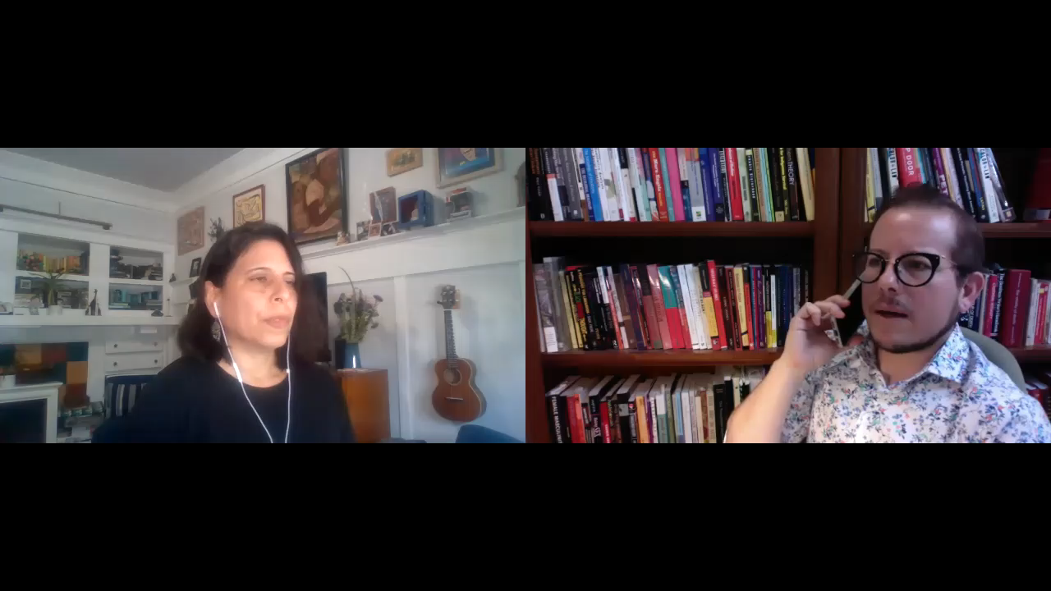
Video
Reflective statements – The Right Way
Notes:
Let’s watch an example of reflective statements used in the context of an interview.
How do you think the contact was feeling at the beginning of this conversation?
How about at the end?

Slide 23
Unpacking your Health Coaching Toolbox
Setting the Agenda
Ask-Tell-Ask
Closing the Loop
Action Planning
Addressing Motivation
Notes:
Today we are going to focus on five tools from your health coaching toolbox…
[List] these include setting the agenda, ask tell ask, closing the loop, action planning, and addressing motivation
So let’s turn our attention to the first skill from your health coaching toolbox: Setting the Agenda.

Slide 24
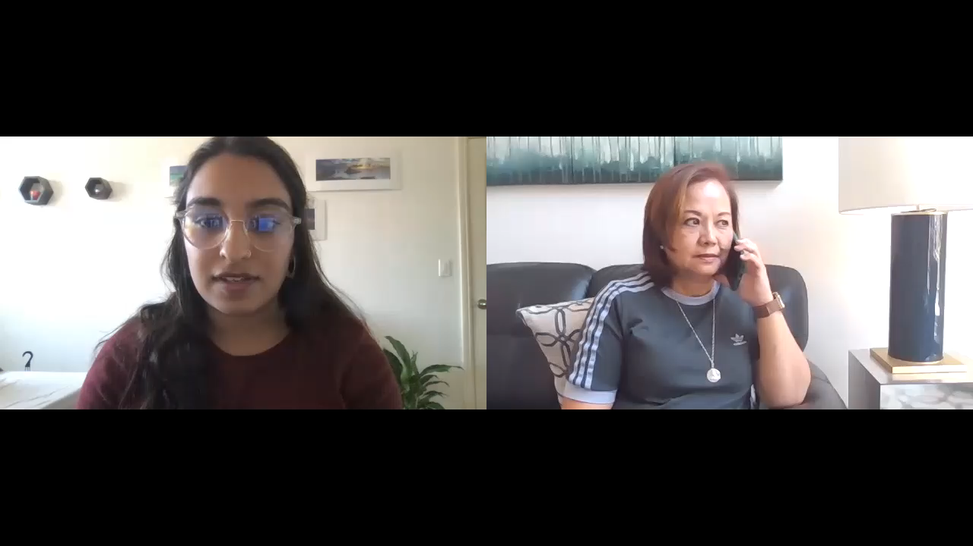
Video
“Are we set?” – Setting the agenda, the wrong way
Notes:
Before we talk about what setting the agenda means, I’d like to show an example of what setting the agenda done poorly looks like.
[Play the video]
In this video, the contact tracer did not ask the contact about her questions or priorities for the conversation. As a result, the contact was distracted by her unanswered concerns about getting her prescriptions. The contact tracer also did not lay out her goals for the call, which resulted in the contact experiencing a barrage of questions without understanding their purpose. The contact in this scenario cut off the conversation, which may be a signal that she is not convinced of the value and purpose of the conversation.

Slide 25
What is setting the agenda?
Identifying what both the contact tracer AND the contact hope to cover in the conversation and agreeing on how best to use the time
Notes:
Setting the agenda is about laying out our priorities for the call but it is ALSO about understanding the priorities of the contact or case. Fundamentally, setting the agenda is agreeing with our contact about how best to use the limited time that we have available.

Slide 26
Steps to Setting the Agenda
1. “What questions or concerns do you hope to talk about today?”
“How do I take care of my dog? And how can I get food for myself?”
1. Ask what concerns or questions the contact would like to talk about
2. “I would also like to ask you about any symptoms you may have had.”
2. Share what you hope to talk about
3. “I am happy to share some resources for food with you. However, I’m new in my role and am not sure about resources for your pet. Would it be okay if I get back to you about that?”
3. Identify what from the contact’s concerns you can address today and what you may need to seek help in answering
4. “Great! So today we’ll be talking about food resources, symptoms, and I will ask my supervisor about resources for your pet and will get back to you.”
4. Briefly summarize all of the agenda items: yours and the contacts
Notes:
Setting the agenda has four steps…
Step 1 is What questions or concerns do you hope to talk about today?
[Next slide]
That might sound like, How do I take care of my dog? And how can I get food for myself?
Step 2 is…
[Next slide]
That might sound like this..

Slide 27
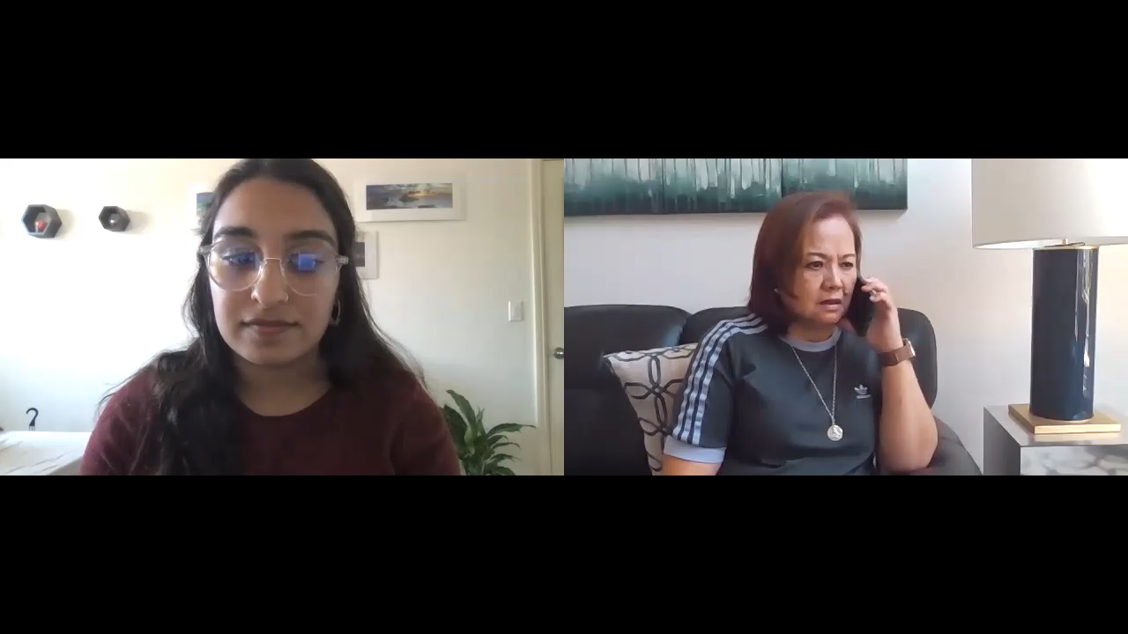
Video
“We are set!” – Setting the agenda, the right way
Notes:
So let’s return to the same interaction
[Play video]
In this dialogue the contact tracer came to an agreement with the contact about how they would use their time on the phone. Because the contact has described her primary concerns and been reassured that they will be addressed, she is open to discussing other topics, such as symptoms, that are on the contact tracer’s mind.

Slide 28
Reasons for Using Interviewing Techniques
IT WORKS!
A small intervention can have a big effect!
The opposite approach, confrontational counseling, has poor results.
It makes our jobs easier and more enjoyable.
It reflects the values of contact tracing.
Notes:
As we wrap up this first section, I’d like to make an argument for why we use some of these interviewing techniques…
[Read from slide]

Slide 29
A Word about Self-care
Take a breath, be good to yourself....
Step away, take a break from the work and the pandemic media
Take care of your body
Make time to unwind
Connect with others
Go ahead, use resources – many good online sites!
Notes:
Before we wrap up this module, here are a few words about self care. CT work can be exhausting in many ways, including mentally and emotionally. It’s critically important that you remember to take care of yourself, and take the time that you need. That’s going to look different for each of you, but here are some ideas.

Slide 30
This is important work, but it is emotionally taxing. Take time for self-care.

Slide 31
Learning Objectives Review
By the end of this session, the learner will be able to:
Define active listening skills to apply to interviews
Learn the steps to setting the agenda to begin interview process

